Slide 1
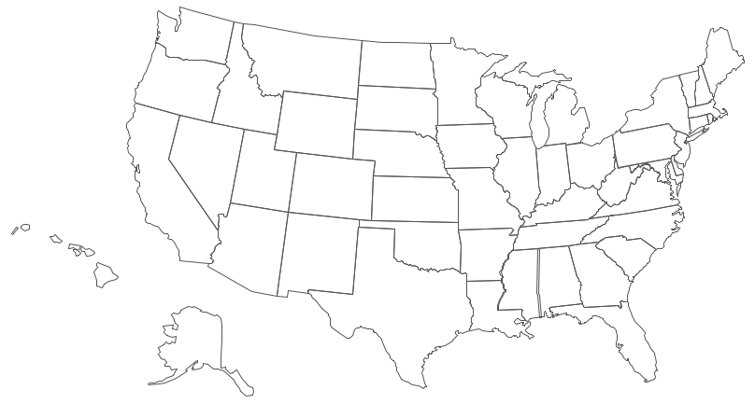
= Delivered LHS M&M’s for website content ideas/comments, etc.
= LHS M&M’s distribution center
See NE Map for detail

